Slide 1
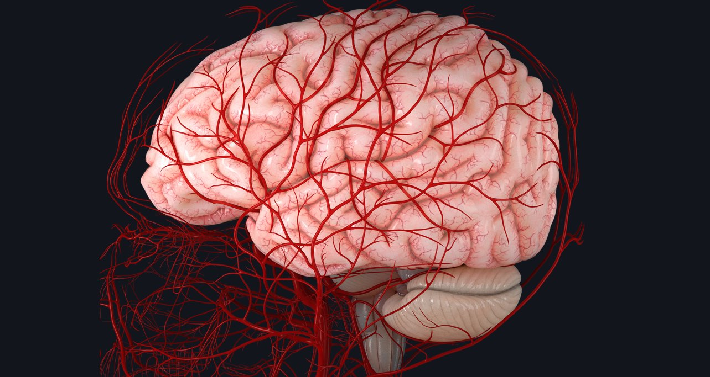
Blood Supply of the Brain and Spinal Cord
Tampaki Ekaterini Christina, MD, Pharm D, PhD, postDoc, Plastic and Reconstructive Surgeon
Filippou Dimitrios MD, PhD, General Surgeon
Assist. Professor of Anatomy

Slide 2
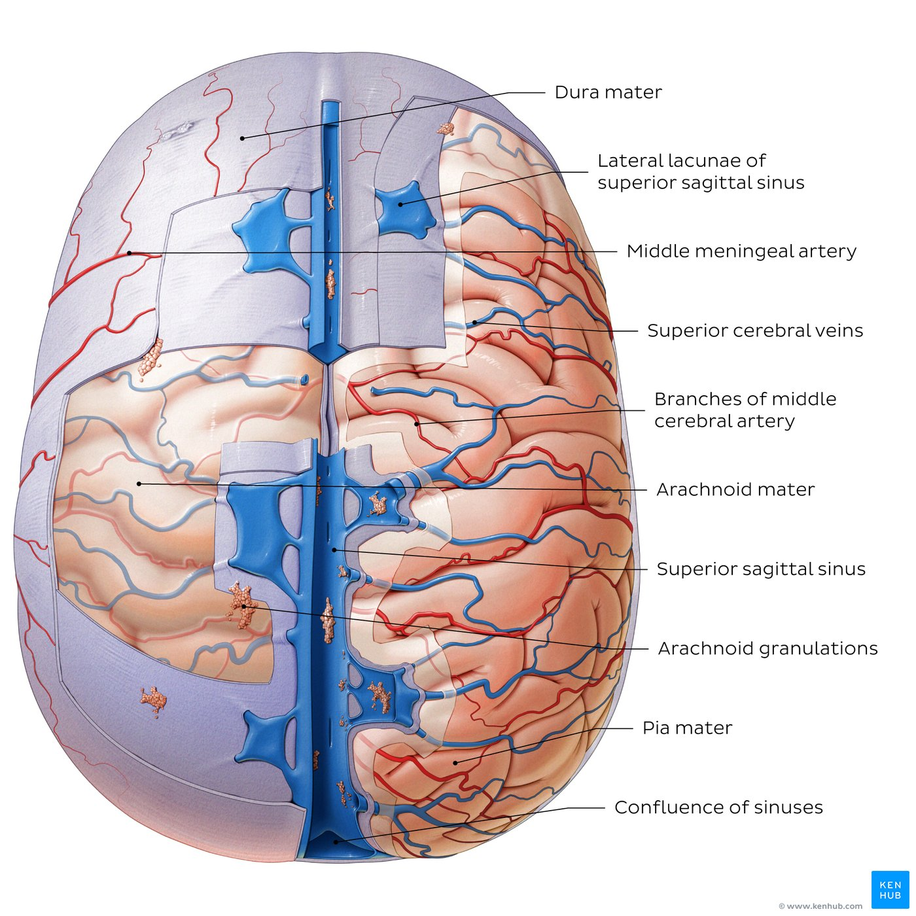
Cranial meninges
Separating the brain and spinal cord from their surrounding bony enclosures are three membranes known as the meninges.
The outermost layer is the dura mater (also known as pachymeninx) which consists of a double layer of thick, dense irregular connective tissue.
The middle layer is the arachnoid mater, so-called for its spider web-like appearance
the innermost layer is the thin and delicate pia mater. The arachnoid and pia mater can also be collectively referred to as the leptomeninges due to their common embryological and cellular structure.
These layers delimitate three clinically important spaces:
the epidural (or extradural),
subdural and
subarachnoid spaces.
The epidural space is located between the bones of the cranium and outer (periosteal) layer of the dura mater, while the subdural space lies between the inner (meningeal) layer of the dura mater and arachnoid mater. Both of these are potential spaces, meaning that under normal circumstances they are closed. The subarachnoid space, located between the arachnoid and pia mater, is a fluid-filled space that contains CSF, as well as cerebral arteries and veins. Finally, separating the pia mater from the surface of the brain is a thin space known as the subpial space.

Slide 3
Key points about the cranial meninges
Definition | Three membranous layers that envelop the brain
Meninges | Dura mater Arachnoid mater Pia mater
Meningeal spaces | Epidural space Subdural space Subarachnoid space Subpial space
Function | Mechanical protection of brain Support of cerebral blood vessels Accommodation and circulation of CSF (subarachnoid space)
Related structures | Dural venous sinuses (venous drainage of the brain) Arachnoid granulations (return of CSF to venous circulation)

Slide 4
Arteries of the Brain
Their branches anastomose to from the
Circle of Willis
Internal carotid arteries
Vertebral arteries

Slide 5
The arterial supply of the brain
The arterial supply of the brain is derived from two primary sources:
the internal carotid and vertebral arteries.
The internal carotid arteries and their branches supply blood to the majority of the forebrain giving them the classification of the anterior cerebral circulation or the internal carotid system.
The vertebral arteries and their major branches supply blood to the spinal cord, brainstem and cerebellum, and a significant part of the posterior cerebral hemispheres (usually the occipital and inferior temporal lobes). The vertebral arteries and their branches are commonly referred to as the vertebrobasilar system or the posterior cerebral circulation.
The cerebral arterial circle (of Willis) is an anatomical structure that provides an anastomotic connection between the anterior and posterior circulations, providing collateral flow to affected brain regions in the event of arterial incompetency.

Slide 6
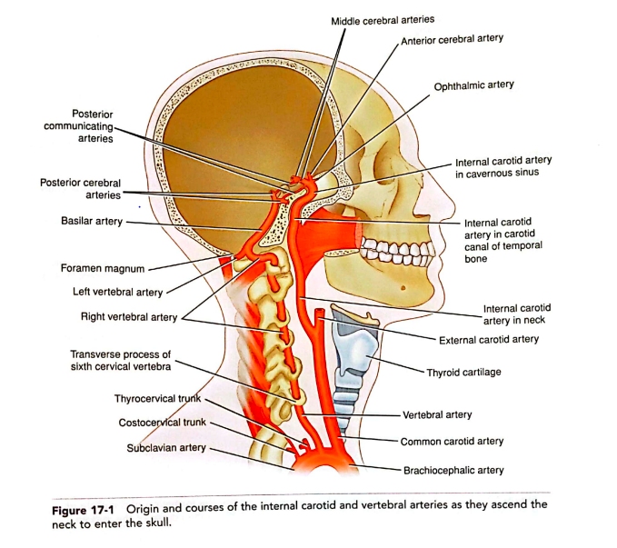

Slide 7
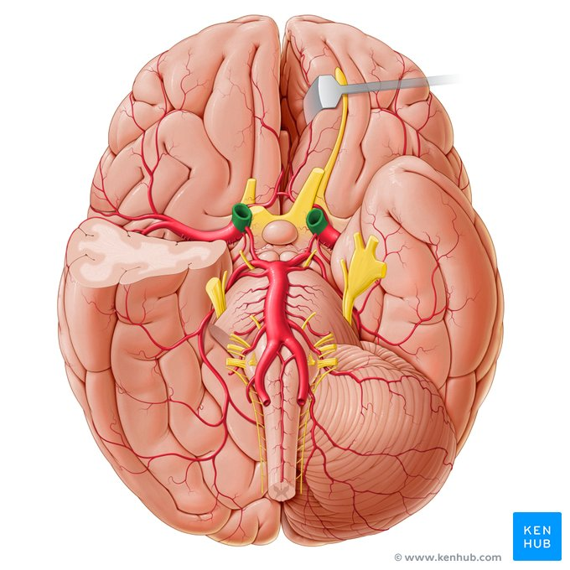
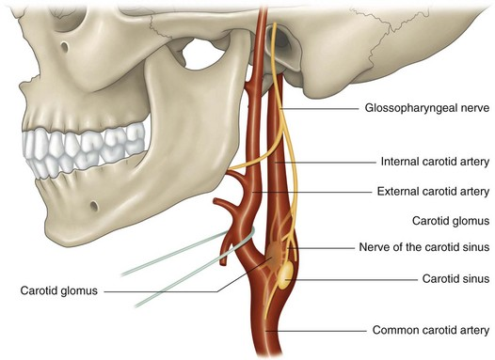
Internal Carotid Artery
Origin: Bifurcation of the common carotid artery

Slide 8
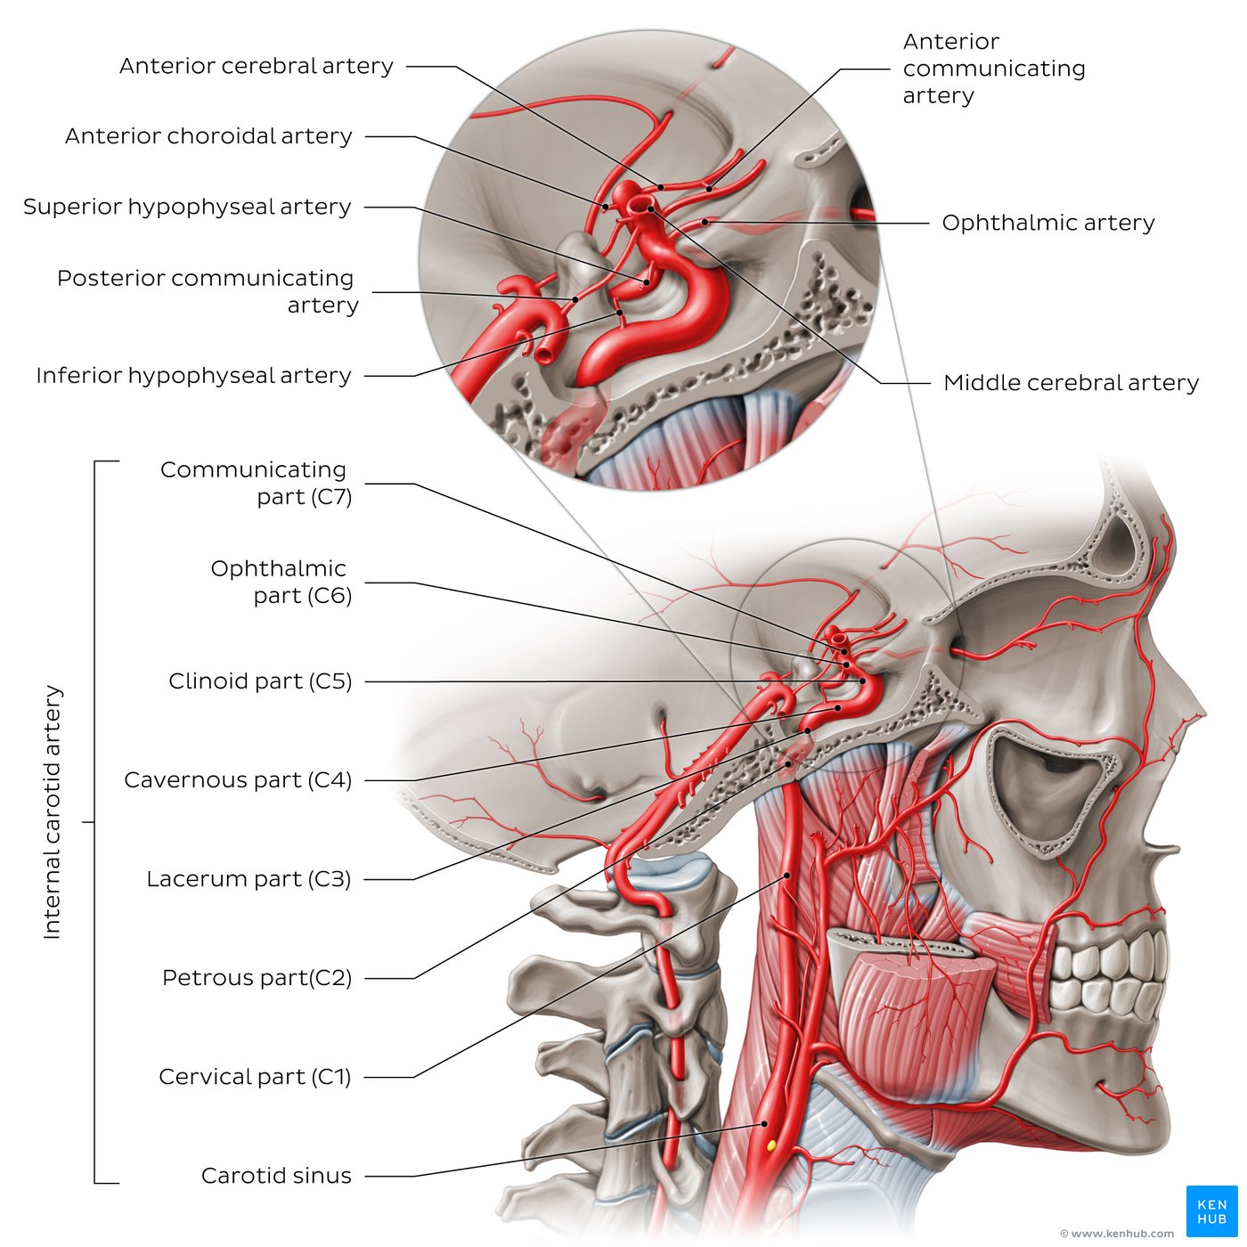
Arteries of the head: ICA
The internal carotid artery (ICA) originates from the common carotid artery.
It is usually divided into seven distinct parts based on its course and anatomical relations. Segments C6/C7 provide several branches which supply the anterior circulation of the brain, as well as the orbit:
the ophthalmic artery
superior hypophyseal artery
posterior communicating artery
anterior choroidal artery
anterior cerebral artery
middle cerebral artery.
The vertebral artery provides blood supply for brainstem, cerebellum, and posterior part of the brain.

Slide 9
Internal Carotid Artery
Course:
Ascends the neck along the side of the pharynx
Passes through the carotid canal of the temporal bone
Passes through the cavernous sinus
Perforates the dura mater and emerges on the medial side of the anterior clinoid process
Perforates the arachnoid mater and enters the subarachnoid space
Turns to the region of the medial end of the lateral cerebral sulcus
Divides into the anterior and middle cerebral arteries

Slide 10
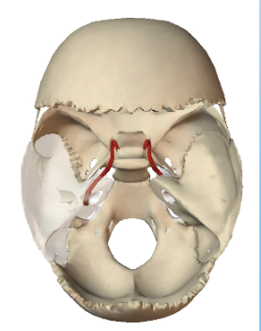
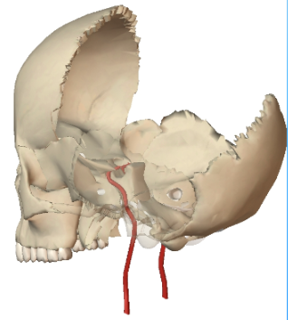

Slide 11
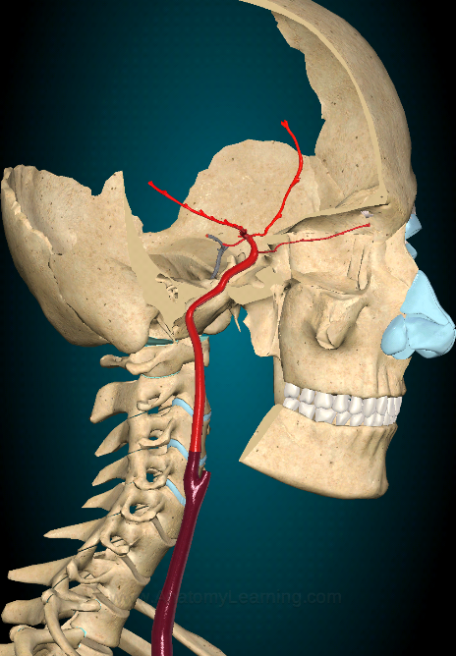
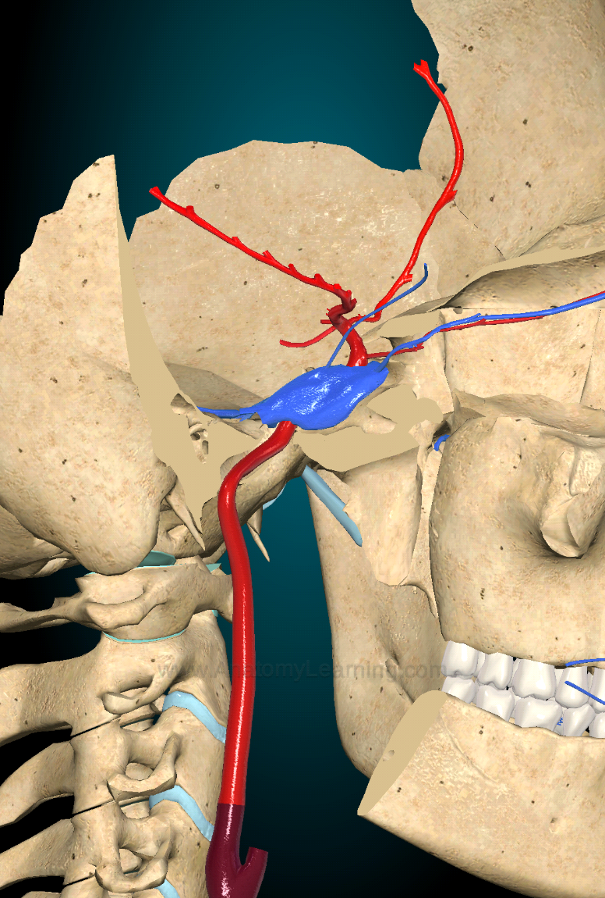

Slide 12
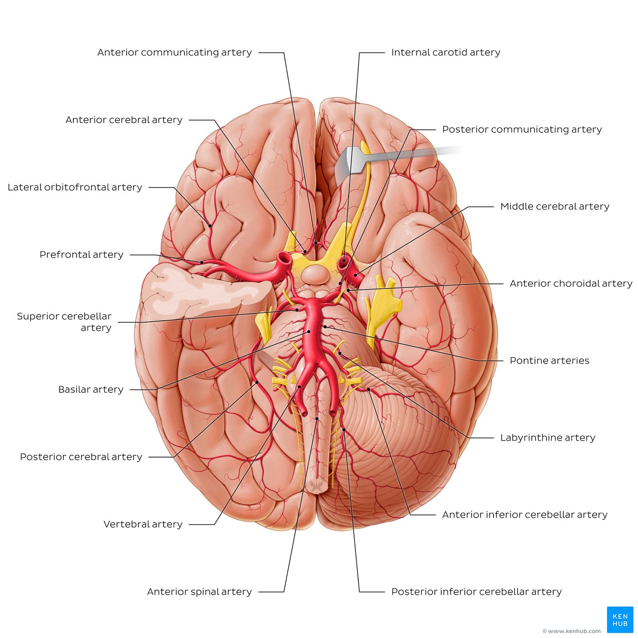
Arteries of the brain: Inferior view
The main artery of the anterior circulation of the brain is the internal carotid artery (ICA), which terminates as the anterior and middle cerebral arteries.
The main artery of the posterior circulation is the vertebral artery. It enters the cranial cavity via the foramen magnum and gives off several branches to the spinal cord, meninges and part of the cerebellum.
The two vertebral arteries then converge to form the basilar artery ﻿which courses vertically across the pons and posterior cranial fossa where it gives off several branches to the rest of the cerebellum, pons, midbrain and internal ear.
The basilar artery terminates as a bifurcation which gives off the paired posterior cerebral arteries that contribute to the cerebral arterial circle (of Willis).
The cerebral arterial circle (of Willis) is an anastomotic loop/ring formed between four paired arteries and one unpaired artery which facilitates collateral blood between the anterior and posterior cerebral circulations as well as the right and left blood supply. Several small perforating (central) arteries emerge from the cerebral arterial circle (of Willis), many of which pass into the brain directly and supply the cortex and subcortical structures.

Slide 13
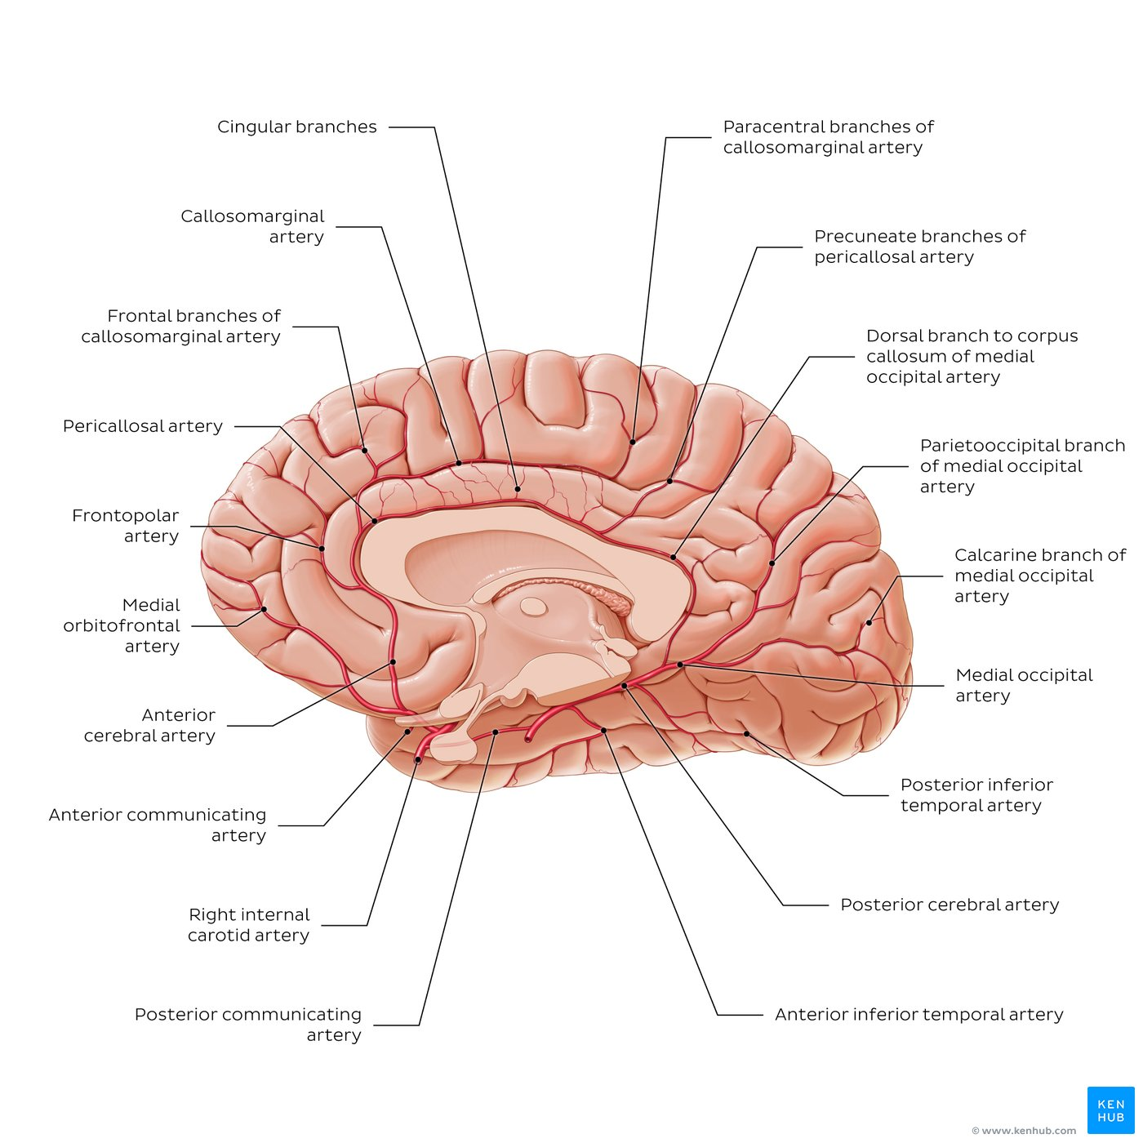
Arteries of the brain: Medial view
Right cerebral hemisphere (without the brainstem and cerebellum) with arteries exposed.
The anterior cerebral artery (ACA) gives off several branches including the anterior communicating artery and cortical branches to the frontal and medial surfaces of the cerebral cortex (frontal, parietal and limbic lobes) and part of the corpus callosum.
The posterior cerebral artery (PCA) gives off several branches to the occipital lobe, the inferolateral surface of the temporal lobe, midbrain, thalamus, choroid plexus (third and lateral ventricle) and cerebral peduncles.

Slide 14
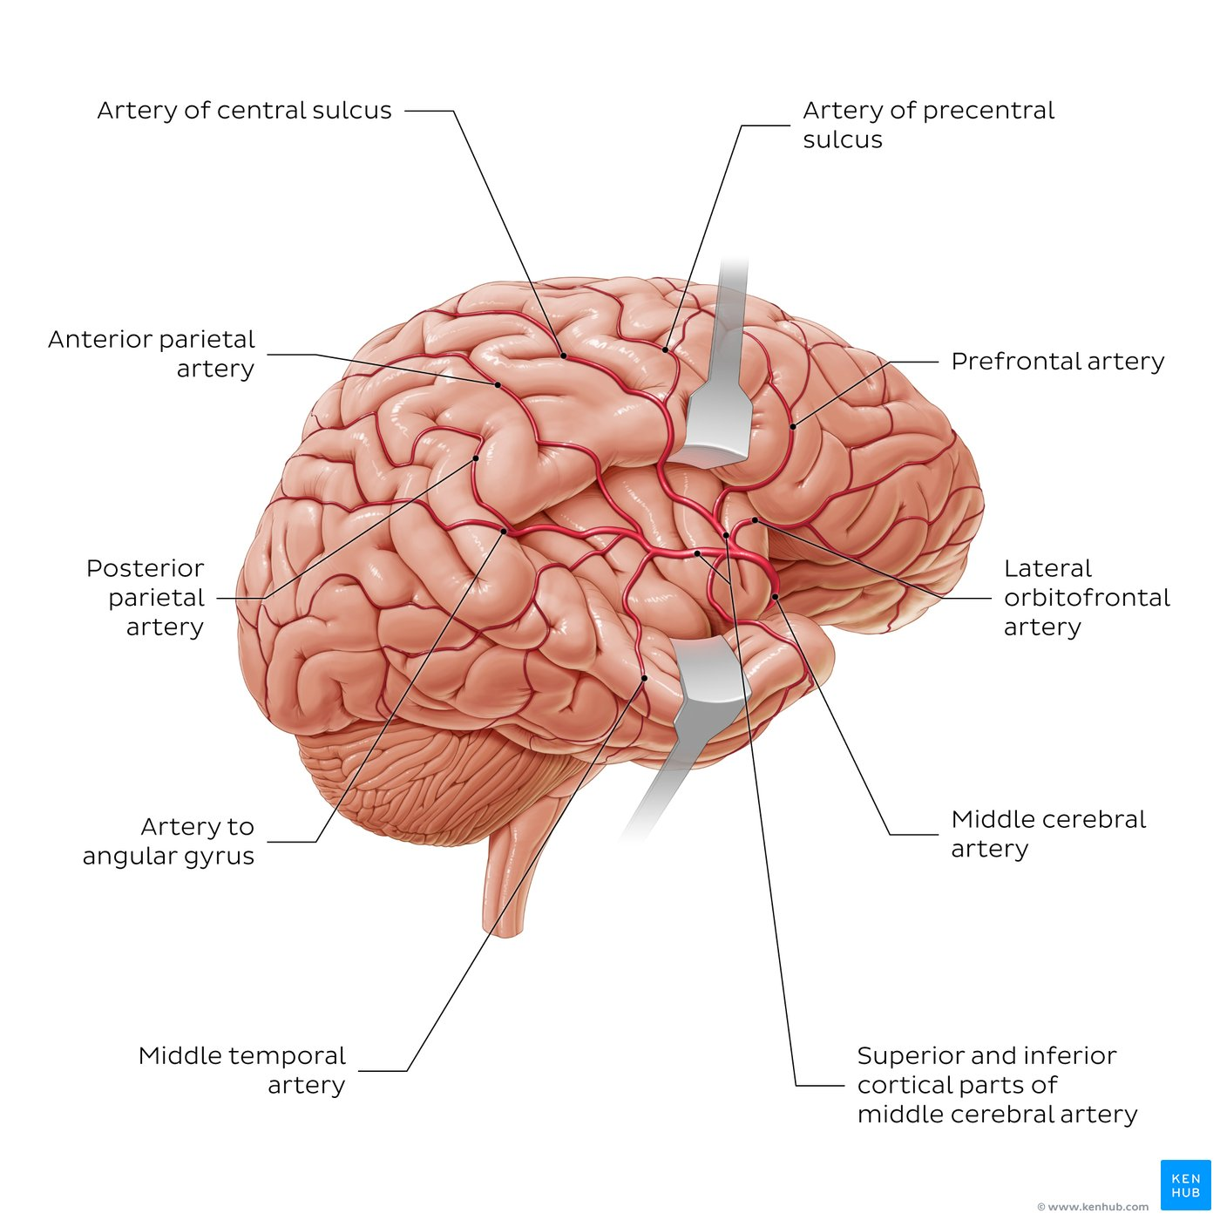
Arteries of the brain: Lateral view
Lateral view of the brain with its arterial vessels; the lateral sulcus has been opened to expose the arteries within.
The prominent vessel seen from this view is the middle cerebral artery (MCA), a terminal branch of the internal carotid artery. It provides a large number of small central branches (which supply the thalamus, basal nuclei and internal capsule) as well as several larger cortical branches to the frontal, parietal, insular and temporal lobes.

Slide 15

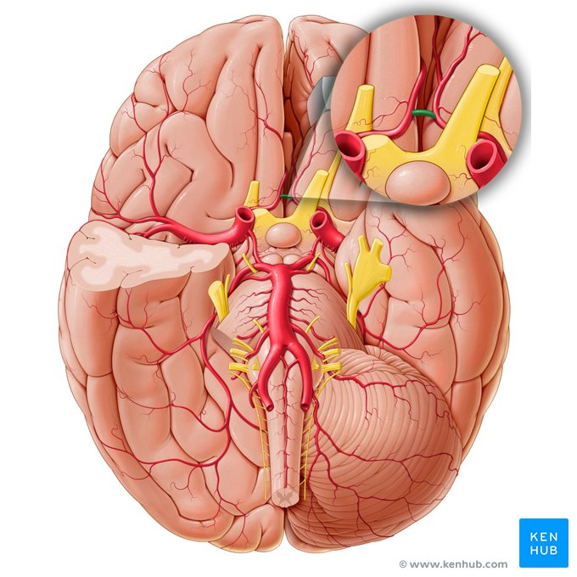





ICA, Anterior Cerebral Artery, Anterior Communicating Artery, Middle cerebral artery, Posterior communicating artery, Posterior cerebral artery, basilar artery, vertebral artery

Slide 16








Anterior spinal artery, posterior inferior cerebellar artery, anterior inferior cerebellar artery, labyrinthine artery, pontine arteries, superior cerebellar arteries, anterior choroidal artery, lateral orbitofrontal artery

Slide 17
Cerebral Portion Branches of the Internal Carotid Artery
Ophthalmic artery
Posterior communicating artery
Choroidal artery
Anterior cerebral artery
Middle cerebral artery

Slide 18
1. Ophthalmic artery
Enters the orbit through the optic canal
Supplies the eye and other orbital structures
Terminal branches supply: frontal area of the scalp
ethmoid and frontal sinuses
dorsum of the nose

Slide 19
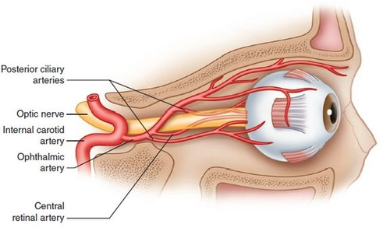

Slide 20
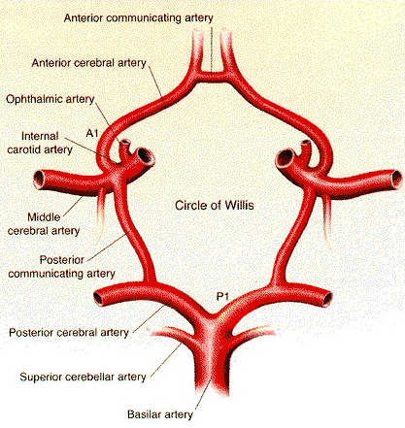
2. Posterior communicating artery
Joins the Posterior cerebral artery (terminal branch of Basilar artery) to form part of the circle of Willis

Slide 21
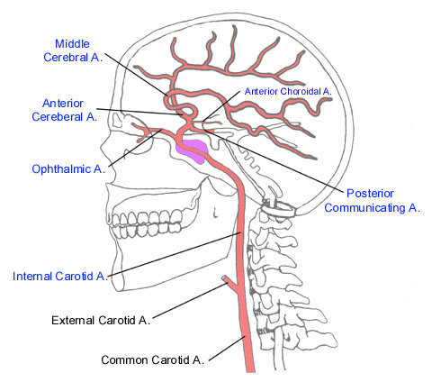
3. Choroidal artery
Enters the inferior horn of the lateral ventricle
Ends in the choroid plexus
Gives off branches to surrounding structures including:
crus cerebri, lateral geniculate body, optic tract, internal capsule

Slide 22
4. Anterior cerebral artery
Enters longitudinal fissure of the cerebrum
Joins the anterior cerebral artery of the opposite side by the anterior communicating artery
Curves backward over the corpus callosum
Anastomoses with the posterior cerebral artery
Cortical branches
Supply:
Entire medial surface of the cerebral cortex as far back as the parieto-occipital sulcus
A strip of cortex about 2.5 cm wide on the adjoining lateral surface
“Leg area”
Central branches
Pierce the anterior perforated substance
Supply:
Parts of the lentiform and caudate nuclei and the internal capsule

Slide 23
5. Middle cerebral artery
Runs laterally in the lateral cerebral sulcus
Cortical branches
Supply: lateral surface of the hemisphere
Entire motor area except the
“leg area” (supplied by the Anterior cerebral artery)
Central branches
Enter the anterior perforated substance
Supply: lentiform and caudate nuclei and internal capsule

Slide 24
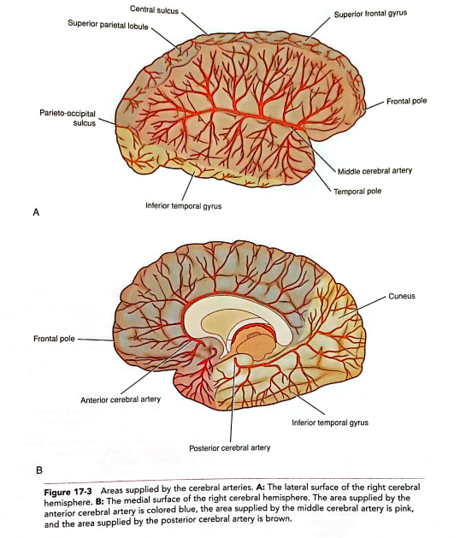

Slide 25
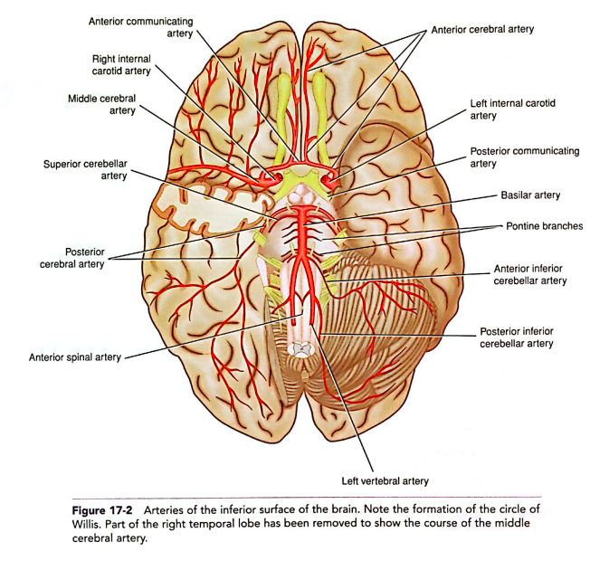

Slide 26
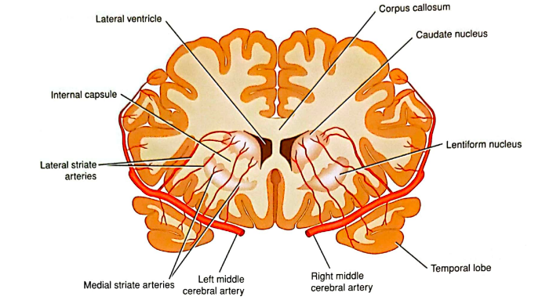

Slide 27

Vertebral Artery
Origin: First part of the subclavian artery
Subclavian artery

Slide 28
Vertebral Artery
Course:
Ascends the neck by passing through the foramina in the transverse processes of the upper six cervical vertebrae
Enters the skull through the foramen magnum
Pierces the dura and arachnoid mater and enters the subarachnoid space
Passes upward, forward and medially on the medulla oblongata
Joins the vessel of the opposite side at the lower border of the pons to form the Basilar artery

Slide 29
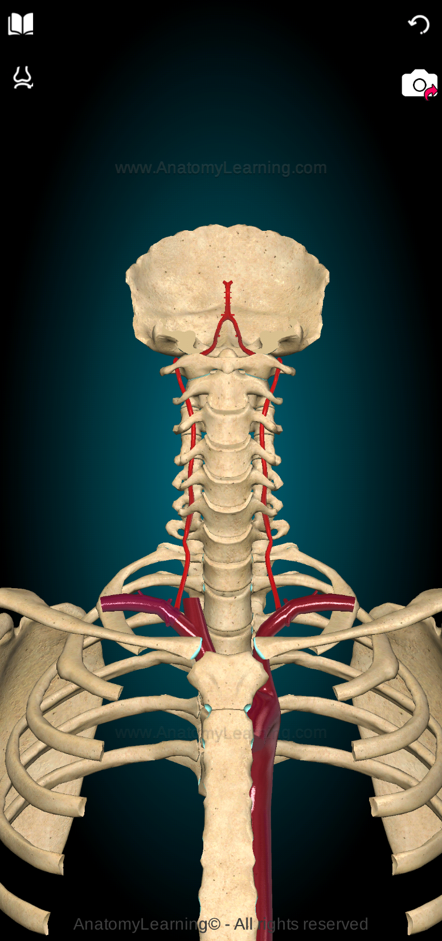
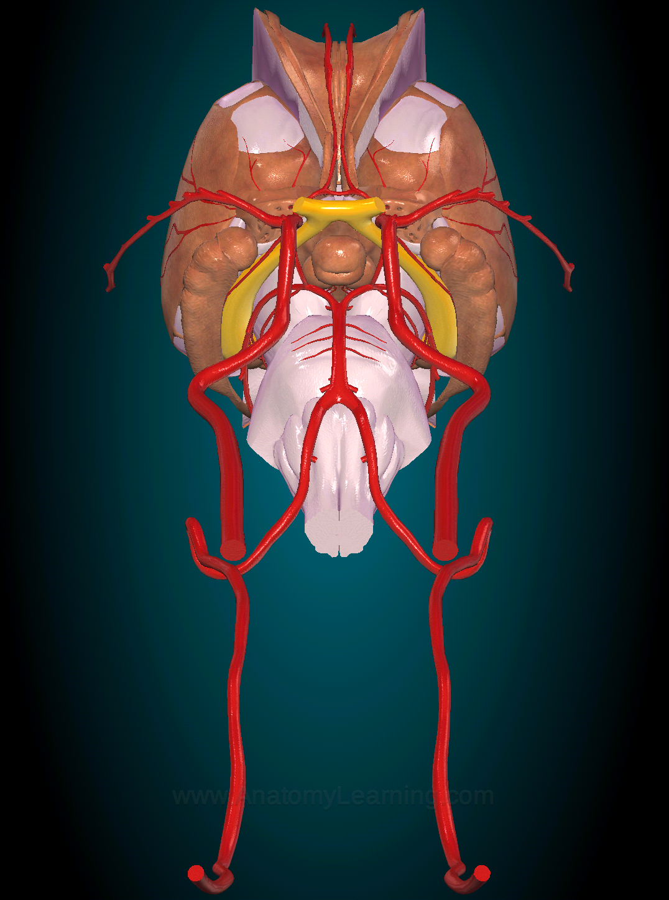

Slide 30
Cranial Portion Branches of the Vertebral Artery
Meningeal branches (supply the bone and dura in the posterior cranial fossa)
Posterior spinal artery
Anterior spinal artery
Posterior inferior cerebellar artery
Medullary arteries (distributed to the medulla oblongata)

Slide 31
2. Posterior spinal artery
3. Anterior spinal artery
May arise from the vertebral artery or the posterior inferior cerebellar artery
Descends on the posterior surface of the spinal cord close to the posterior roots of the spinal nerves
It is formed by a contributory branch from each vertebral artery
Descends on the anterior surface of the medulla oblongata and the spinal cord, embedded in the pia mater along the anterior median fissure

Slide 32
4. Posterior inferior cerebellar artery
Passes between the medulla and the cerebellum
Supplies: inferior surface of the vermis
central nuclei of the cerebellum
undersurface of the cerebellar hemisphere
medulla oblongata
choroid plexus of the fourth ventricle

Slide 34
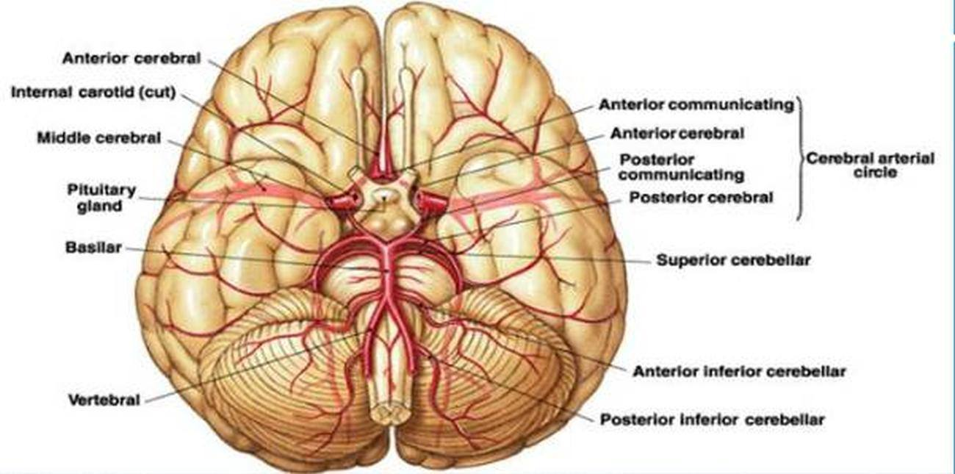
Basilar Artery
Commences as the union of the two vertebral arteries, at the lower border of the pons
Ascends in a groove on the anterior surface of the pons
Terminates by dividing into the two Posterior cerebral arteries, at the upper border of the pons

Slide 35
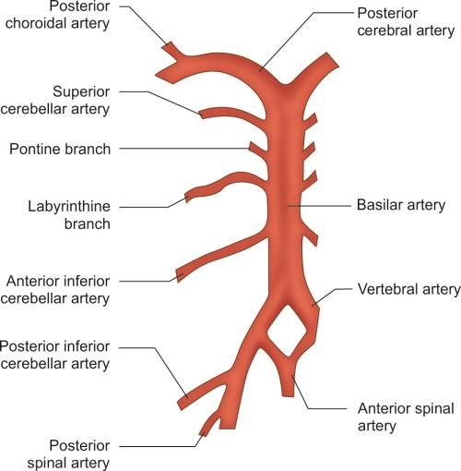

Slide 36
Branches of the Basilar Artery
Pontine arteries (enter the substance of the pons)
Labyrinthine artery (passes into the internal acoustic meatus and supplies the internal ear)
Anterior inferior cerebellar artery
Superior cerebellar artery
Posterior cerebral artery

Slide 37
4. Superior cerebellar artery
3. Anterior inferior cerebellar artery
Supplies the anterior and inferior parts of the cerebellum
A few branches pass to the pons and the upper part of the medulla oblogata
Supplies the superior surface of the cerebellum, the pons, the pineal gland, and the superior medullary velum

Slide 39
5. Posterior cerebral artery
Joined by the Posterior communicating branch (of the Internal carotid artery)
Cortical branches
Supply:
Inferolateral and medial surfaces of the temporal lobe
Lateral and medial surfaces of the occipital lobe
Visual cortex
Central branches
Pierce the brain substance
Supply:
Parts of the thalamus and lentiform nucleus
Midbrain, pineal, and medial geniculate bodies
Choroidal branch
Enters the inferior horn of the lateral ventricle
Supplies the choroid plexus of the lateral and the third ventricle

Slide 42
Circle of Willis
Lies in the interpeduncular fossa at the base of the brain
Is formed by the anastomosis between the two internal carotid arteries and the two vertebral arteries
Contributing arteries: anterior communicating
anterior cerebral
internal carotid
posterior communicating
posterior cerebral
basilar

Slide 43

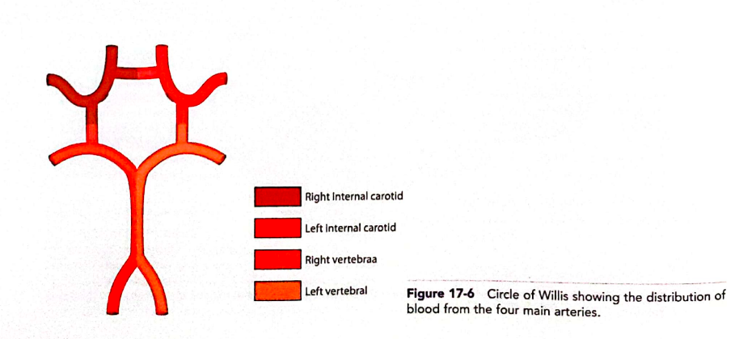
Cerebral arterial circle (of Willis)

Slide 44
Arteries to Specific Brain Areas
Corpus Striatum
Internal Capsule
Middle cerebral arteries
Anterior cerebral arteries
Thalamus
Posterior communicating arteries
Basilar artery
Posterior cerebral arteries
Midbrain
Posterior cerebral arteries
Superior cerebellar arteries
Basilar artery
Pons
Basilar artery
Anterior inferior cerebellar arteries
Superior cerebellar arteries
Medulla Oblongata
Vertebral arteries
Anterior and Posterior spinal arteries
Posterior inferior cerebellar arteries
Basilar artery
Cerebellum
Superior cerebellar arteries
Anterior inferior cerebellar arteries
Posterior inferior cerebellar arteries

Slide 45
Nerve Supply of Cerebral Arteries
Sympathetic postganglionic nerve fibers from the superior cervical sympathetic ganglion
Stimulation of these nerves
Vasoconstriction of the cerebral arteries

Slide 46
Key facts about the arteries of the brain
Anterior circulation | Main arteries: Internal carotid artery, anterior cerebral artery, anterior communicating artery and middle cerebral artery Supply: Forebrain
Posterior circulation | Main arteries: Vertebral artery, basilar artery, posterior cerebral artery and posterior communicating artery Supply: Posterior cerebral cortex (occipital lobe and partly temporal lobe), midbrain, brainstem
Cerebral arterial circle (of Willis) | (from anterior to posterior): Anterior communicating artery (from the anterior cerebral artery) Anterior cerebral arteries (from the internal carotid artery) Internal carotid arteries (from the common carotid artery) Posterior communicating arteries (from the posterior cerebral artery) Posterior cerebral arteries (branch of the basilar artery)
Supply | Anterior cerebral artery: Frontal, parietal and cingulate cortex; corpus callosum, region of the brain primarily responsible for motor and sensory of the lower limbs Middle cerebral artery: Most of the lateral surface of the frontal, parietal and temporal lobes (except for the superior border of the former two and inferior border of the latter), basal ganglia and internal capsule Posterior cerebral artery: Occipital lobe, inferolateral surface of the temporal lobe, midbrain, thalamus, choroid plexus (third and lateral ventricle), cerebral peduncles

Slide 47
Veins of the Brain
No valves
No muscular tissue
Thin walls
They emerge from the brain and lie in the subarachnoid space
They pierce the arachnoid mater and the meningeal layer of the dura and drain into the cranial venous sinuses
Consist of the External and Internal Cerebral Veins

Slide 48
Venous system of the brain
The brain is an especially well-vascularized organ, receiving approximately twenty percent of cardiac output. The veins of the brain drain the blood from the entire brain as well as the surrounding structures (meninges, eyeballs etc). The drained blood is then first returned to the dural venous sinuses and then the internal jugular vein. Structurally, the veins of the brain lack a muscular layer (tunica media), which allows them to expand and collapse substantially. There are two types of venous systems that drain the blood from the brain. These are the superficial (external) venous system and the deep (internal) venous system.
The superficial cerebral veins are found in the subarachnoid space (i.e. between the arachnoid and pia mater) on the external surface of the cerebrum. They are divided into groups in relation to the part of the brain that they drain: the superior, middle and inferior cerebral veins.
The deep venous system of the cerebrum is composed of a series of venous sinuses and deep cerebral veins. Numerous medullary veins extend throughout the white matter of the cerebrum, and drain into subependymal veins along the inner surface of the lateral ventricles leading to the formation of larger cerebral veins mainly internal cerebral veins, basal vein (of Rosenthal) and great cerebral vein (of Galen). The subependymal veins and subsequent deep medullary veins drain into the dural sinuses before emptying into the internal jugular vein.
Venous drainage of the cerebellum is achieved by the superior and inferior cerebellar veins which drain into the great cerebral vein (of Galen), the straight sinus, the superior petrosal sinus, or the sigmoid sinus.
Veins of the brainstem form an intricate plexus deep to the arteries of the brainstem and drain to the veins of the spinal cord, basal vein, great cerebral vein (of Galen), cerebellar veins and/or the dural venous sinuses.

Slide 49
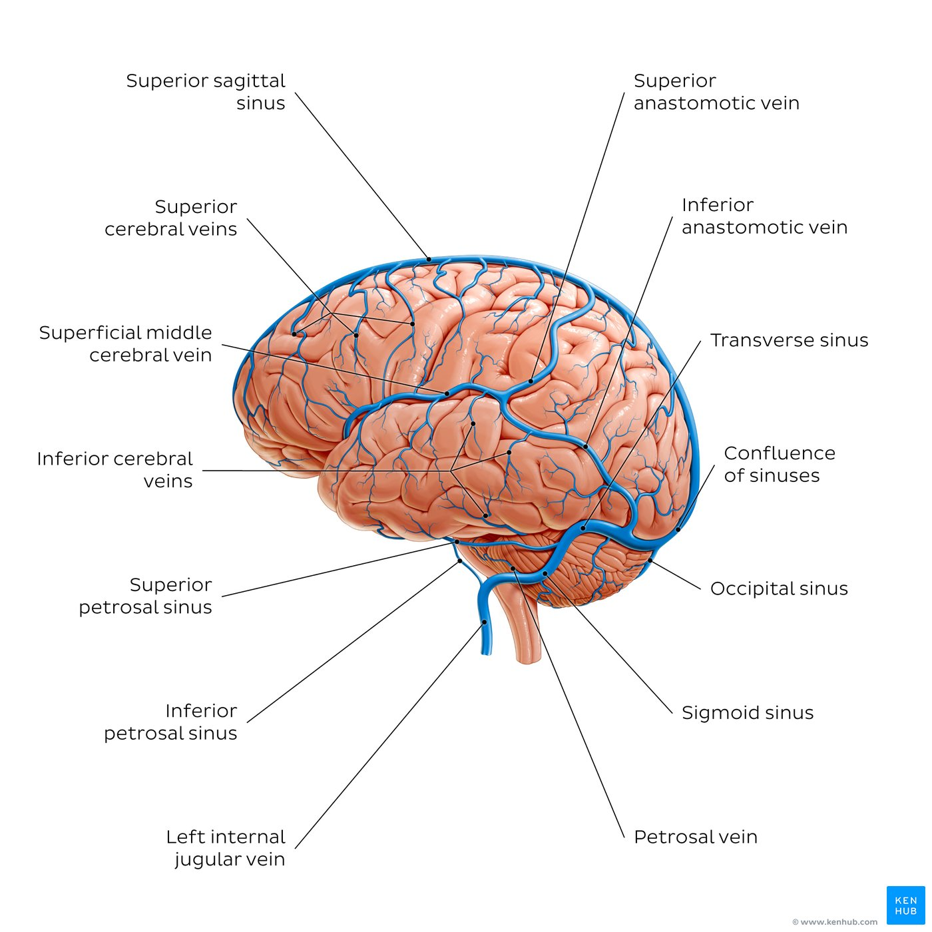
Superficial cerebral veins: Lateral view
There are approximately eight to twelve superior cerebral veins that drain the superolateral and upper medial surfaces of each cerebral hemisphere.
They are small in caliber, and they usually follow the cerebral sulci towards the superomedial margin of the cerebral hemisphere and drain into the superior sagittal sinus. They can be divided into frontopolar, frontal, central, parietal and occipital veins.
The superficial middle cerebral vein courses along the lateral cerebral fissure. It drains blood from most of the lateral surface of the cerebral hemisphere and conveys it to the cavernous sinus, following a course along the lateral sulcus. It communicates with the superior sagittal sinus and transverse sinus via the superior anastomotic vein (of Troland) and inferior anastomotic vein (of Labbé), respectively.
The inferior cerebral veins drain the inferior portion of the cerebral hemisphere. Temporal and occipital veins [on the lateral and basal surfaces] empty into the superficial middle cerebral and basal veins, as well as the superior petrosal and/or transverse sinuses. Orbitofrontal veins (not seen) empty into the anterior end of the superior sagittal sinus, superficial middle cerebral vein and/or basal vein.

Slide 50
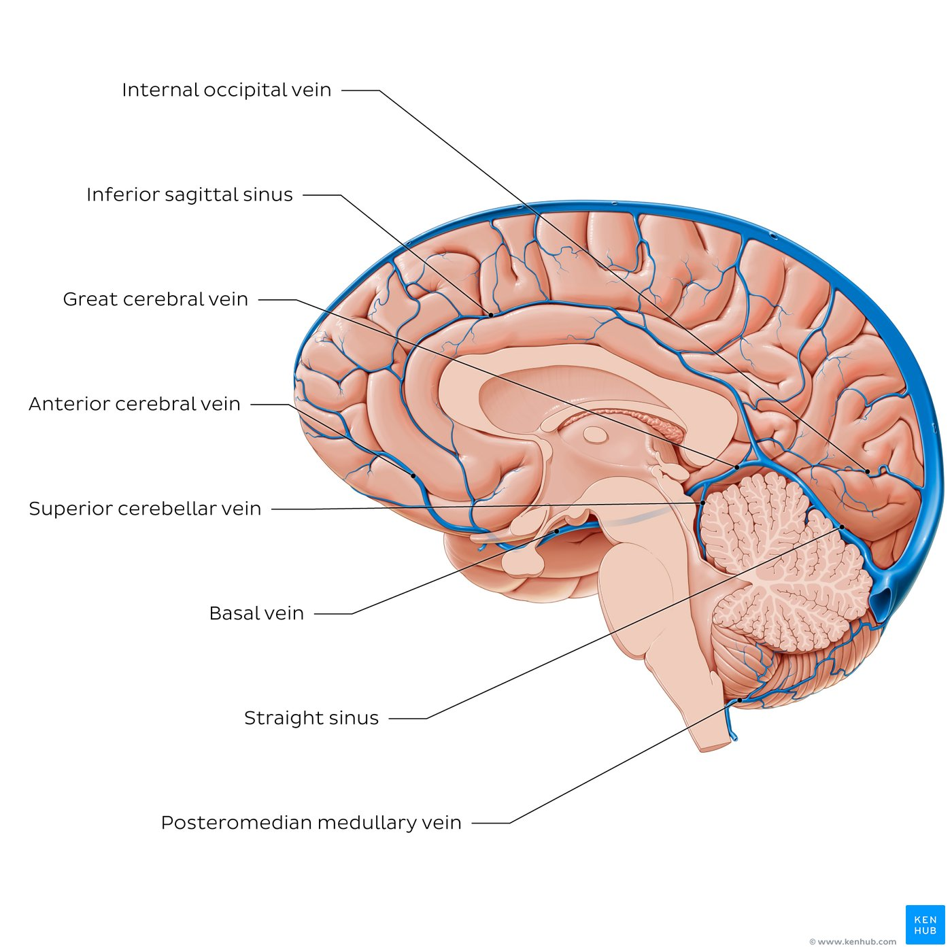
Deep cerebral veins: Medial view
Located between the periosteal and meningeal layers of dura mater are the dural venous sinuses. Generally venous blood from deeper structures of the cerebrum drain into deep cerebral veins which extend and empty into three dural venous sinuses:
the transverse, straight and sigmoid sinuses.
The straight sinus receives the inferior sagittal sinus and the great cerebral vein (of Galen). It runs in a posteroinferior direction towards the internal occipital protuberance and contributes to the formation of the confluence of sinuses. Emerging from this confluence are the paired transverse sinuses which travel within the lateral border of the tentorium cerebelli.
The transverse sinuses terminate as they extend to form the sigmoid sinuses at the point where the tentorium cerebelli ends. The sigmoid sinuses course along the floor of the posterior cranial fossa and empty into the internal jugular veins as they leave the cranium via the jugular foramina. Tributaries of the sigmoid sinus include the mastoid and (posterior) condylar emissary veins as well as veins which drain the cerebellum, namely the inferior cerebellar veins.

Slide 51
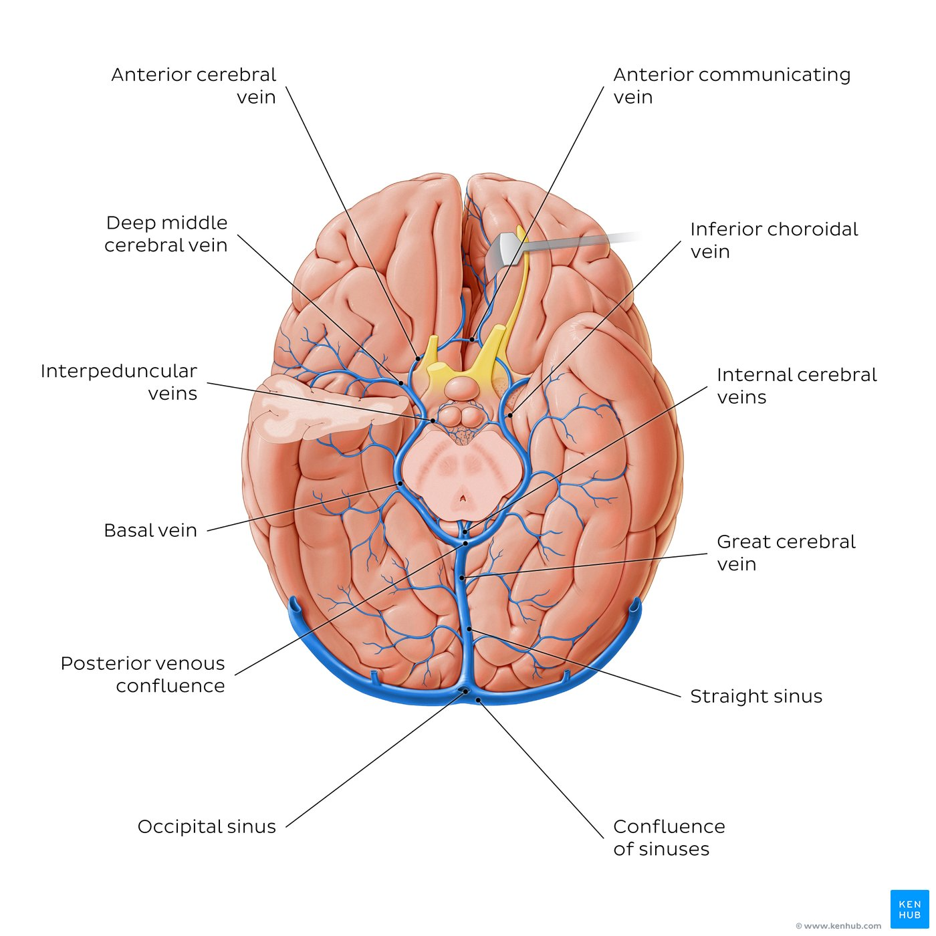
Deep cerebral veins: Inferior view
The medullary veins converge with the subependymal veins to form greater tributaries of the sinuses including the great cerebral vein (of Galen), thalamostriate veins, internal cerebral vein and the basal vein.
The main vein of the deep venous system of the cerebrum is the great cerebral vein (of Galen) which has two major sets of tributaries: the internal cerebral vein and the basal vein.
The internal cerebral vein originates around the foramen of Monro and is formed by the union of two veins: the superior thalamocerebral veins and the superior choroidal vein. The internal cerebral vein is closely related to the thalamus and the choroid plexuses of the lateral and third ventricles.
The second major tributary is the basal vein,running posteriorly and is closely related to the midbrain structures. It has four main tributaries: the anterior and deep middle cerebral vein, the inferior thalamostriate veins and the inferior choroidal vein.
Before the great cerebral vein terminates it receives tributaries which include the posterior vein of corpus callosum, the lateral direct cerebral veins and the superior thalamostriate vein, joined by the inferior sigmoid sinus and terminates as it anastomoses with the straight sinus at the junction between the falx cerebri and tentorium cerebelli.

Slide 52
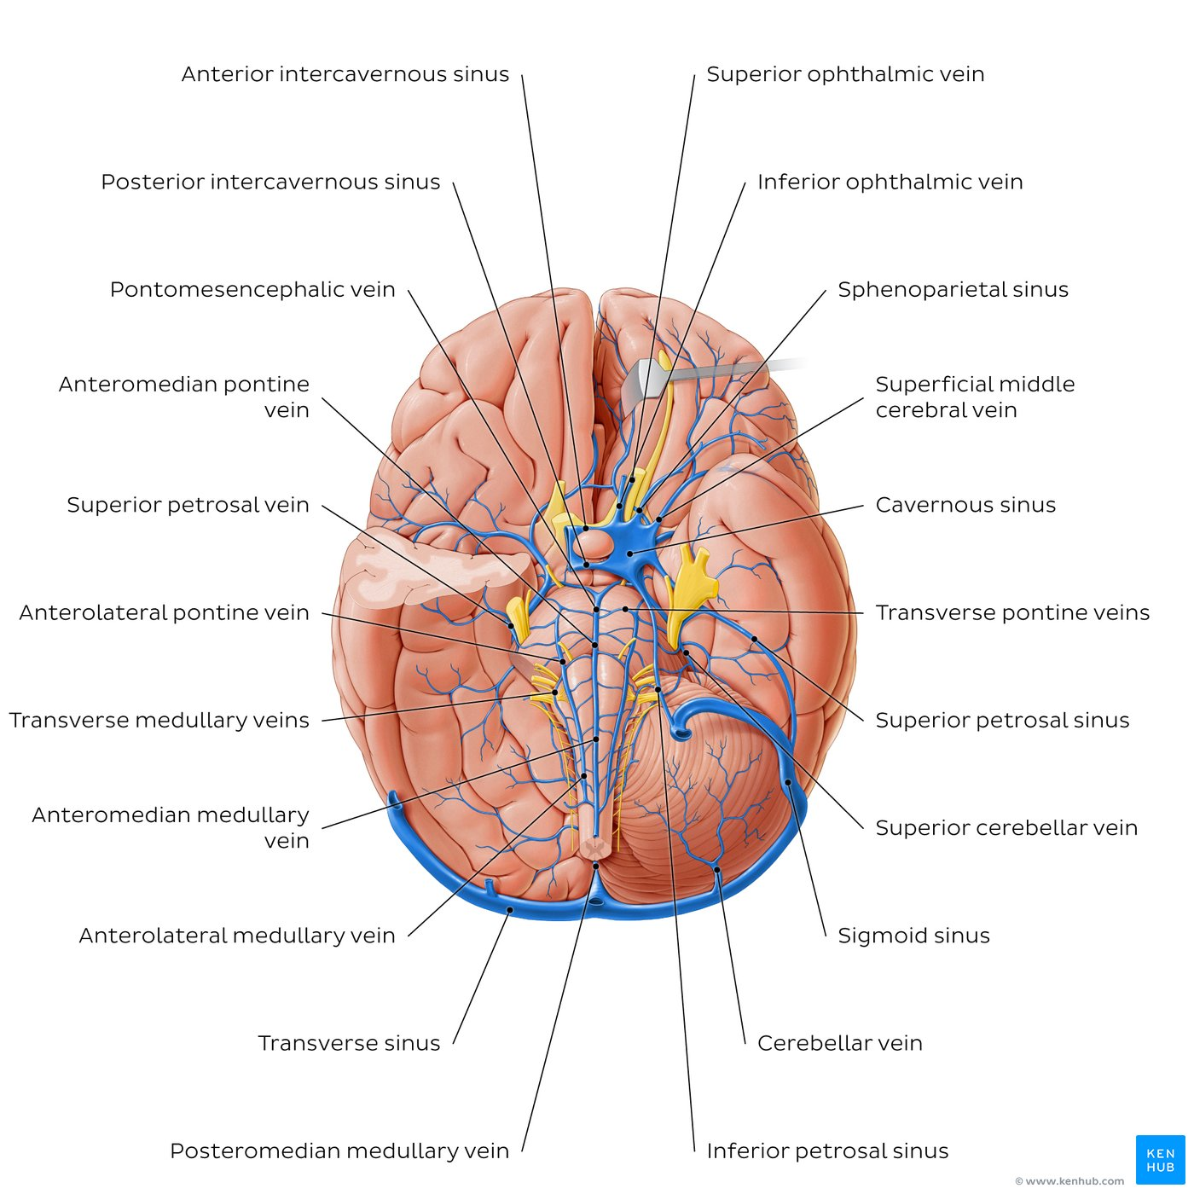
Veins of the brainstem and cerebellum: Inferior view
Venous drainage of the cerebellum is achieved through the superior and inferior cerebellar veins, the cerebellar vein (precentral cerebellar vein) and the petrosal vein.
The superior cerebellar veins mainly drain the superior region of the cerebellum and empty into the straight sinus, the great cerebral vein (of Galen), the transverse sinus and/or the inferior petrosal sinus. It is formed by the inferior cerebellar veins, also known as the internal cerebellar veins. Their tributaries drain blood from the inferior cerebellum into the right and left sigmoid sinuses, the inferior petrosal sinus, the occipital and straight sinuses..
The venous drainage of the brainstem involves a superficial plexus of veins which drain blood from the midbrain, pons and medulla oblongata to the vertebral veins, the veins of the spinal cord, and the basilar and inferior petrosal sinuses, as well as into the basal and great cerebral veins.

Slide 53
External Cerebral Veins
Superior Cerebral Veins
Pass upward over the lateral surface of the cerebral hemisphere
Empty into the superior sagittal sinus
Superficial Middle Cerebral Vein
Drains the lateral surface of the cerebral hemisphere
Runs inferiorly in the lateral sulcus
Empties into the cavernous sinus
Deep Middle Cerebral Vein (drains the insula)
Anterior Cerebral Vein
Striate vein
Join to form the
Basal Vein
Joins the Great Cerebral Vein and drains into the straight sinus

Slide 54
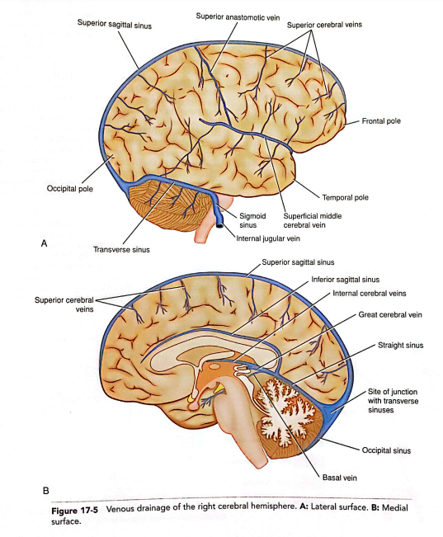

Slide 56
Internal Cerebral Veins
Formed by the union of the thalamostriate vein and the choroid vein at the interventricular foramen
Run in the tela choroidea of the third ventricle
Unite beneath the splenium of the corpus callosum to form the great cerebral vein (empties into the straight sinus)

Slide 57
Veins of Specific Brain Areas
Midbrain
Drained by veins that open into the basal or great cerebral veins
Medulla Oblongata
Drained by veins that open into the spinal veins and neighboring venous sinuses
Pons
Drained by veins that open into the basal vein, cerebellar veins, or neighboring venous sinuses
Cerebellum
Drained by veins that empty into the great cerebral vein or adjacent venous sinuses

Slide 58
Key facts about the veins of the brain
Superficial cerebral veins | Superior cerebral veins: Frontopolar vein, frontal veins, central vein, parietal veins, occipital veins Superficial middle cerebral vein (of Sylvius): Frontal veins, parietal veins, temporal veins, superior anastomotic vein (of Trolard), inferior anastomotic vein (of Labbé) Inferior cerebral veins: Orbitofrontal veins, vein of uncus, temporal veins, occipital veins
Deep cerebral veins | Great cerebral vein (of Galen): Main tributaries: Internal cerebral vein, basal vein, posterior vein of corpus callosum, lateral direct cerebral veins, superior thalamostriate vein and inferior sagittal sinus Internal cerebral vein: Main tributaries: Superior choroidal vein and superior thalamocerebral veins Basal vein: Main tributaries: Anterior cerebral vein, deep middle cerebral vein, inferior thalamostriate veins and inferior choroidal vein
Veins of cerebellum | Superior cerebellar vein Inferior cerebellar vein
Veins of brainstem | Midbrain: Veins of midbrain → great cerebral vein (of Galen) or basal vein Pons: Pontine veins → basal vein, cerebellar veins, petrosal sinuses, transverse sinus or venous plexus of foramen ovale Pontomesencephalic vein → superior petrosal sinus Medulla oblongata: Medullary veins → inferior petrosal, occipital sinuses, internal jugular vein or radicular veins of spinal cord

Slide 59
Key facts about the dural venous sinuses
Definition | A collection of sinuses or blood channels that drains all venous blood from the cranial cavity and returns it towards the heart
Location | Situated between periosteal and meningeal layers of dura mater
Paired venous sinuses | Transverse sinus, cavernous sinus, superior petrosal sinus, inferior petrosal sinus, sphenoparietal sinus, sigmoid sinus, basilar sinus
Unpaired venous sinuses | Superior sagittal sinus, inferior sagittal sinus, straight sinus, occipital sinus, intercavernous sinus

Slide 60
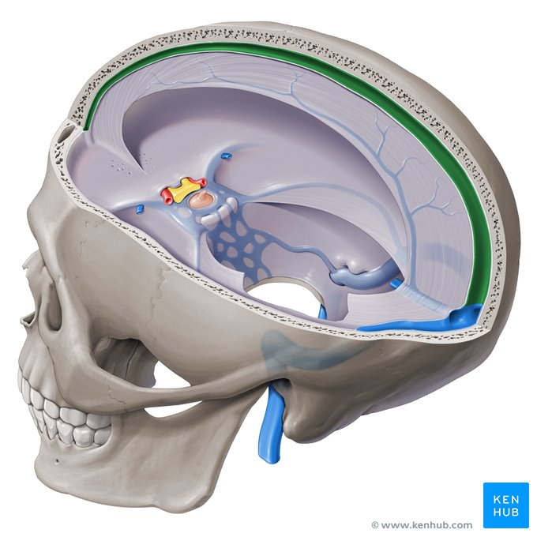
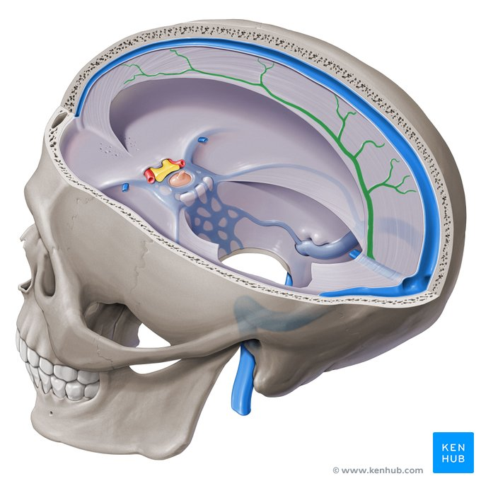
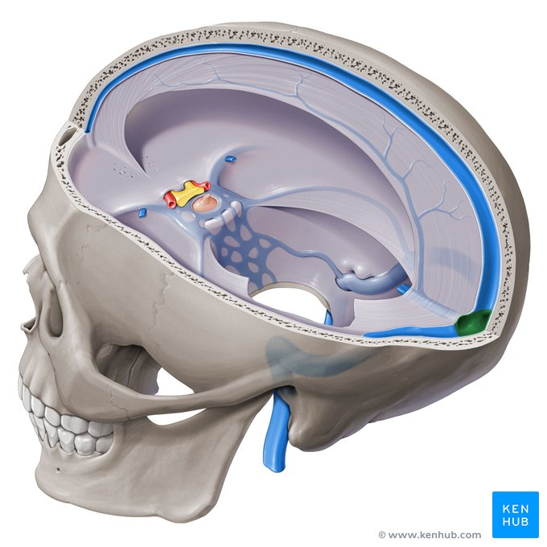
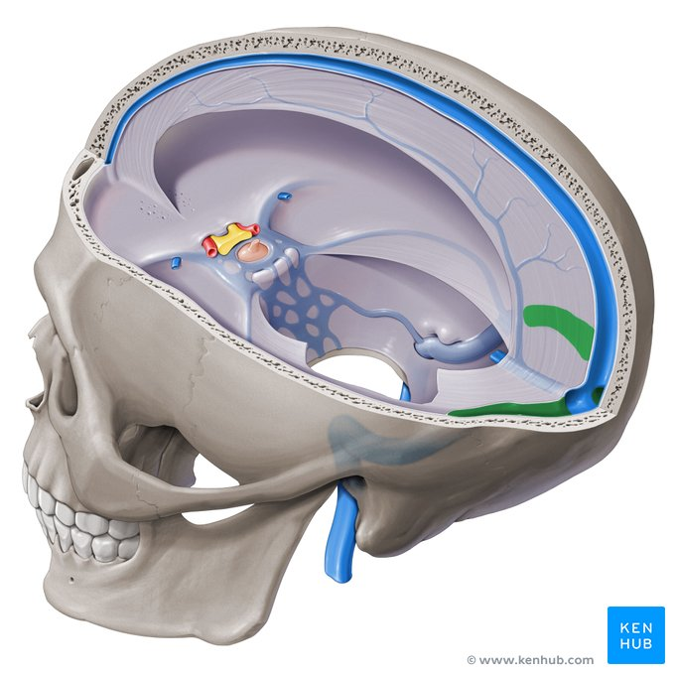

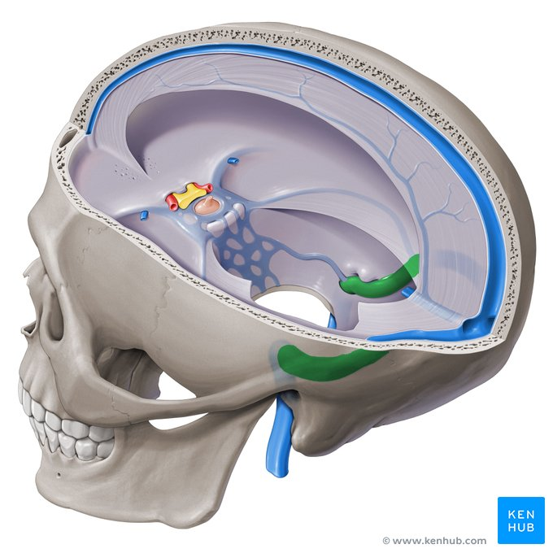
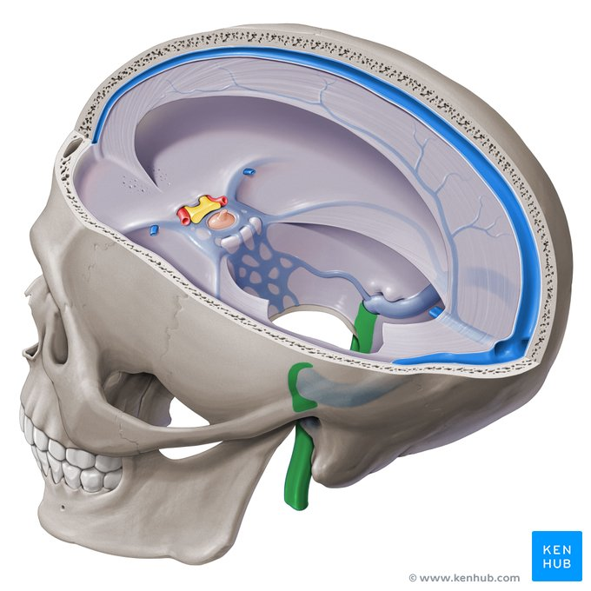
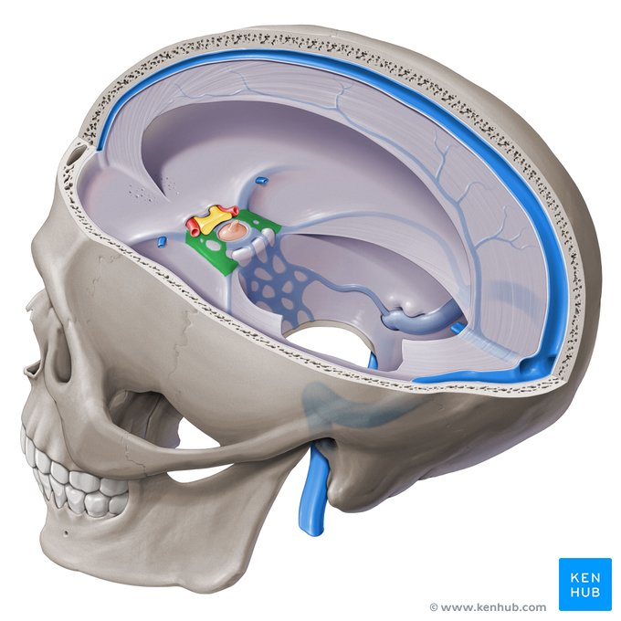
Superior sagittal sinus, inferior sagittal sinus, confluence of sinuses, transverse sinus, straight sinus, sigmoid sinus, internal jugular vein, cavernous sinus

Slide 61
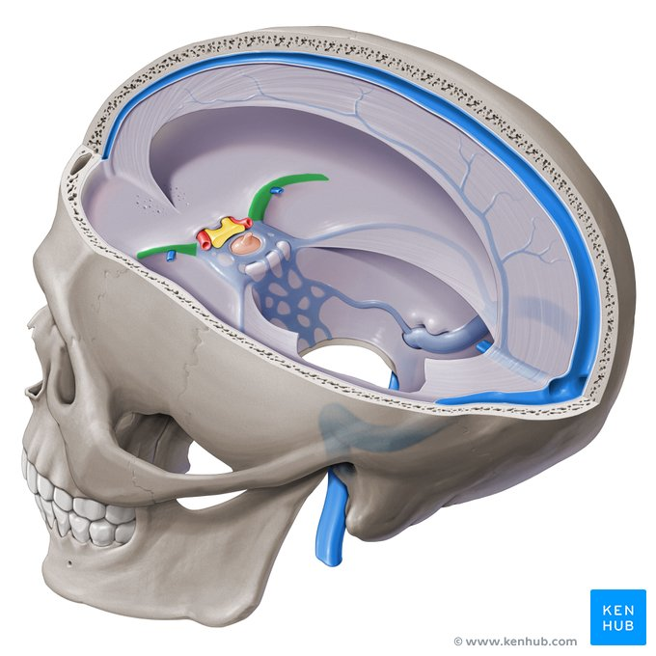
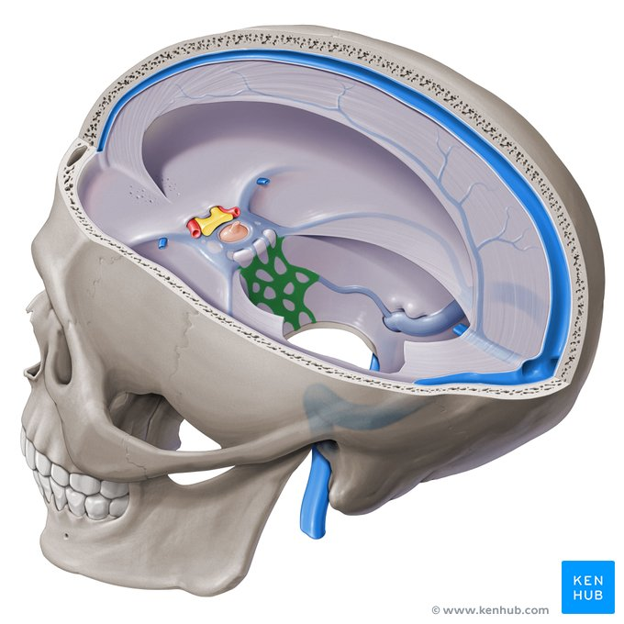
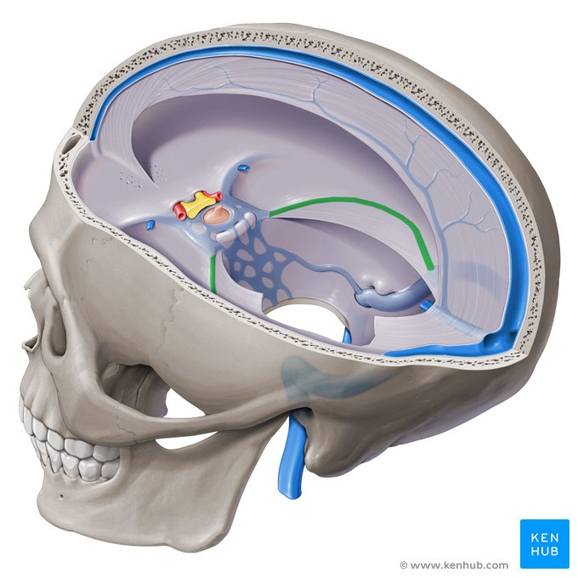

Sphenoparietal sinus, basilar venous plexus, superior petrosal sinus, inferior petrosal sinus,

Slide 62
Brain Capillaries
Capillary blood supply to the brain:
Gray matter > White matter
Greater metabolic activity in the neuronal cell bodies
The tight junctions between the endothelial cells in the capillary beds form the blood-brain barrier

Slide 63
Cerebral Circulation
Normal cerebral blood flow per minute is approximately
50 to 60 mL/100g of brain tissue
The blood supply to half of the brain is provided by the adjacent internal carotid and vertebral arteries, and their respective streams come together in the posterior communicating artery at a point where the pressure of the two is equal and they do not mix
Cerebral blood flow remains remarkably constant in spite of changes in the general blood pressure

Slide 64
Spinal Cord Arteries
Reinforced by
Segmental Spinal Arteries:
Arise from arteries outside the vertebral column
Enter the vertebral canal through the intervertebral foramina
Anastomose on the surface of the cord
Send branches into the substance of the white and gray matter
Posterior Spinal Arteries (2)
Anterior Spinal Artery

Slide 65
Posterior Spinal Arteries
May arise from the vertebral artery or the posterior inferior cerebellar artery
Descend on the posterior surface of the spinal cord close to the posterior roots of the spinal nerves
Give off branches that enter the substance of the cord
Supply the posterior 1/3 of the spinal cord

Slide 66
Anterior Spinal Artery
It is formed by a contributory branch from each vertebral artery
Descends on the anterior surface of the spinal cord, embedded in the pia mater along the anterior median fissure
Gives off branches that enter the substance of the cord
Supplies the anterior 2/3 of the spinal cord

Slide 67
Segmental Spinal Arteries
Branches of arteries outside the vertebral column (deep cervical, intercostal, lumbar)
Enter the vertebral canal and give rise to anterior and posterior radicular arteries that accompany the anterior and posterior nerve roots to the spinal cord
Feeder arteries
Great anterior medullary artery of Adamkiewicz: important feeder artery, arises from aorta, major source of blood to the lower 2/3 of the spinal cord

Slide 68
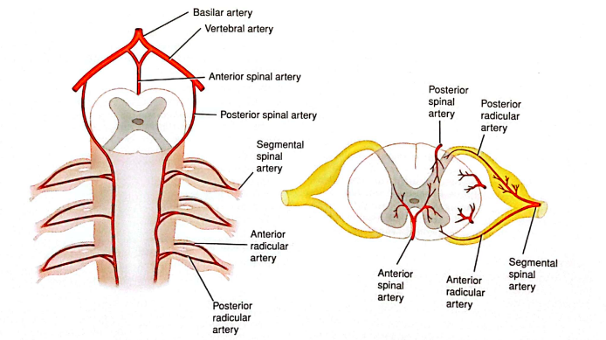

Slide 69
Spinal Cord Veins
Drain into six tortuous longitudinal channels that communicate superiorly within the skull with the veins of the brain and the venous sinuses
Drain mainly into the internal vertebral venous plexus

Slide 71
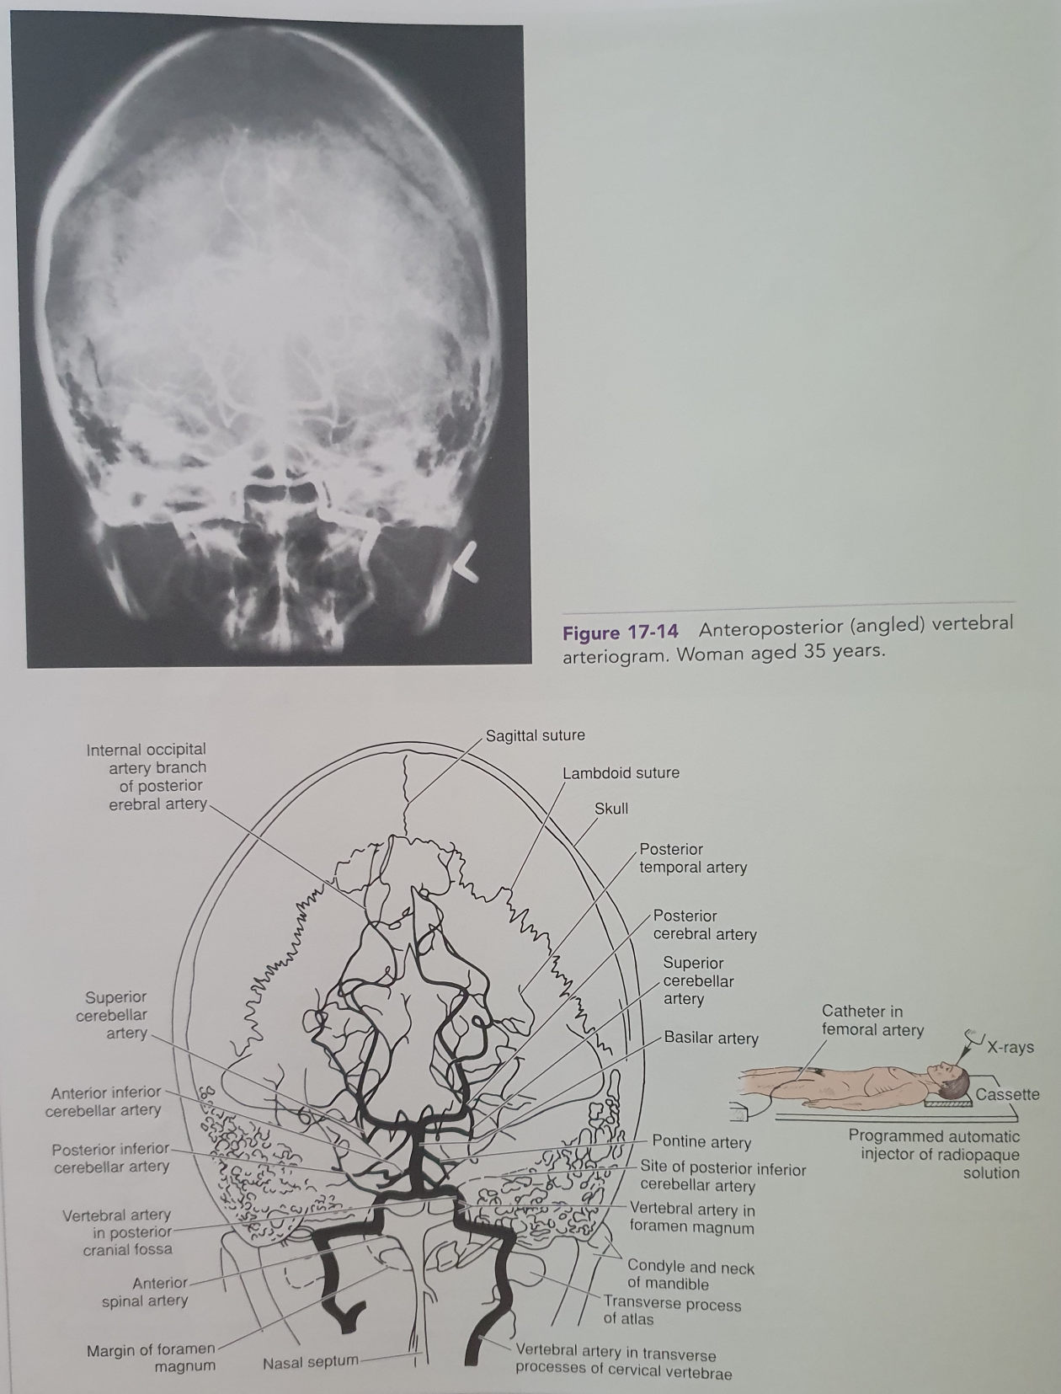

Slide 72
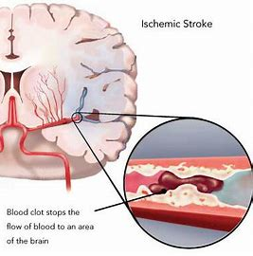
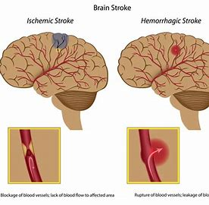
Clinical Notes 1
Cerebral Ischemia
5-10 sec
1min
4min
5min
Cerebral Circulation Occlusion

Slide 73
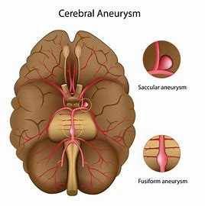
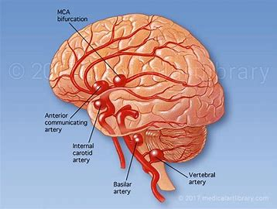
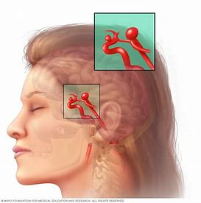
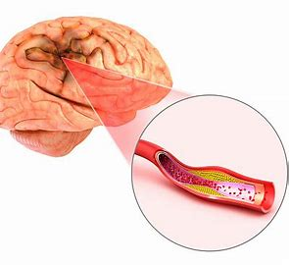
Clinical Notes -2
Cerebral Blood Flow Impairment
Postural Hypotention
Physical and Psychological Stress
Blood Viscocity Changes
Carotid Sinus Syndrome
Heart Disease
Arterial wall diseases
Cerebral Aneursyms
Congenital
Other

Slide 74
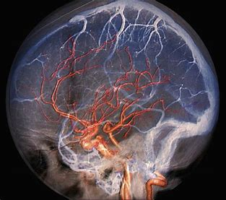
The images and the text of the slides are used exclusively for educational purposes.
Thank you
Questions?

